Slide 1

Year 5 C25
Preparation for practice 1:
Primary and preventative care

Slide 2
WELCOME
Please put your name and Cypher number in the Chat box
(SUMDE payment)
https://www.qub.ac.uk/sites/qubgp/

Slide 3



The C25 journey

Slide 4
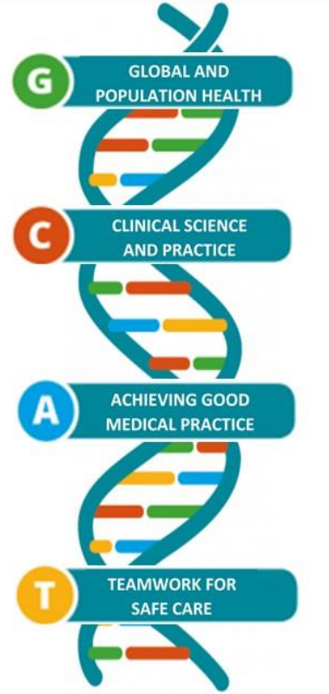
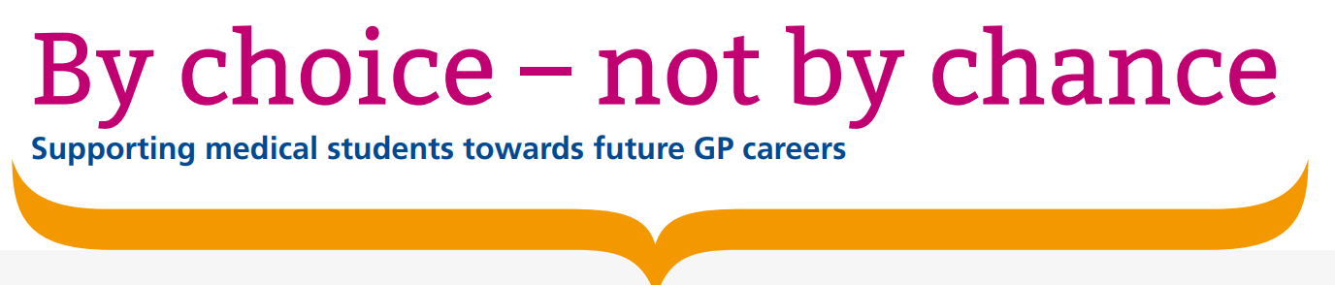


Exposure of undergraduates to authentic GP teaching and subsequent entry to GP training: a quantitative study of UK medical schools. Hugh Alberti et al British Journal of General Practice 2017; 67 (657): e248-e252.
25%

Slide 5
Year 5 GP placements C19 C25
From 5 weeks (2x2 plus 1 week Assistantship) to 7 weeks continuously
  1 x induction instead of 3x
  Students become part of the team (and community….)
  More and more independent and increased complexity
After written MLA exam

Slide 6

When are the students coming to the practice? Are there any days/weeks they will not be in practice? Attendance and absence?
What is expected from the tutor and the practice?
How has the student progressed until now and how can we help the student to progress further? What if I have concerns?
What kind of learning activities will the student be looking for or should we signpost the student to?
What is expected from the student?
Is there any signing off to be done?

Slide 7
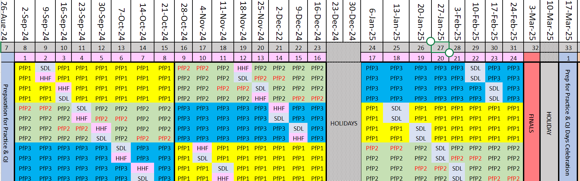

JUNE 2024
WRITTEN FINALS (MLA AKT)

Slide 8
When will the students NOT be in practice?
Every 2nd or 3rd week of each 8-week block:
Week of 9 Sept or week of 16 Sept
Week of 4 Nov or week of 11 Nov
Week of 13 Jan 25 or week of 20 Jan 25
1x session a week - Theme based learning (QUB supported)

Slide 9
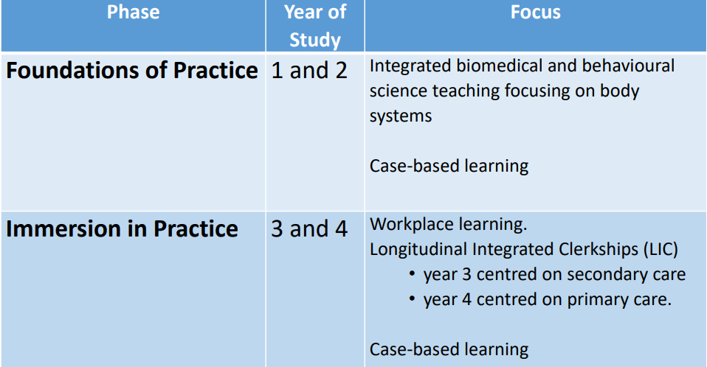
The student’s journey up to now

Slide 10


Slide 11
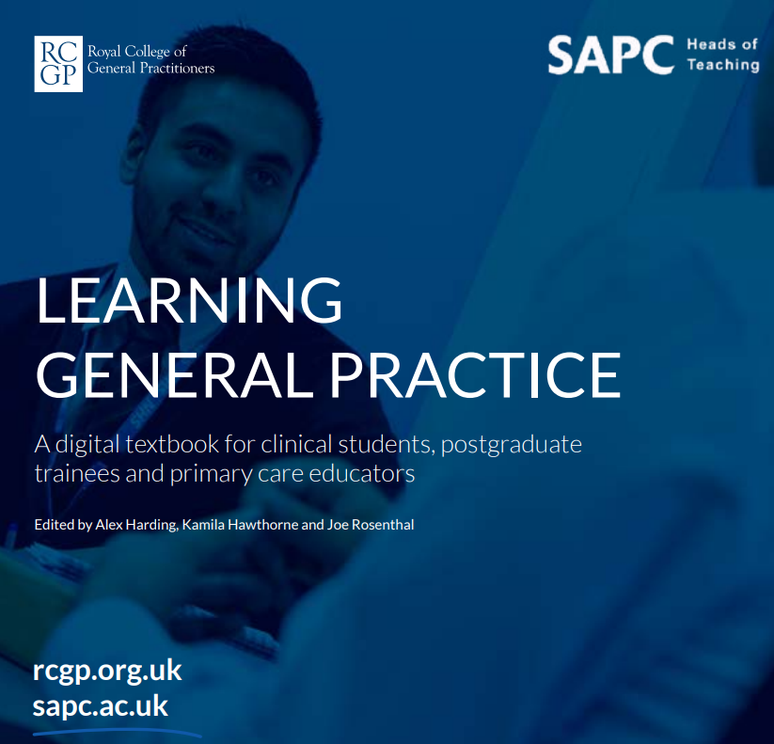
The student’s journey in GP

Slide 12
General Practice across the QUB Medical School Curriculum 2024/2025
Year 5
Year 1
Year 2
Year 3
Year 4
FAMILY MEDICINE
Family Attachment
5 sessions inc. home visits
FAMILY MEDICINE
General Practice Experience
5 sessions
GENERAL PRACTICE
ATTACHMENT
12 sessions
GENERAL PRACTICE
LONGITUDINAL CLERKSHIP
4 x 2 weeks
Preparation for Practice (primary and preventative care)
7 weeks

Slide 13


Each year the GP attachment has a different ‘focus’

Slide 14
Holistic care (the biopsychosocial model) (includes dealing with uncertainty, prescribing/ adherence/ polypharmacy/social prescribing)
The physiology of holistic care (includes Medically Unexplained Symptoms)
The doctor-patient relationship
Communication with patients of all backgrounds
Continuity of care and integrated care
Long-term conditions in i) Diagnostic phase, ii) Maintenance phase, iii) End of life care
Emergency conditions
Multi-morbidity and complexity
The social determinants of health
Preventing disease and promoting health
Medical ethics
Effective delivery of care –
The generalist approach, also includes sustainable healthcare

Slide 15
Year 5
Emergency and same day care
Multi-morbidity and complexity
Preventing disease and promoting health
Integrated care

Slide 16
What do students think about PfP1/GP placements in year 5?
Confidence in patient consultations
Opportunity to review patients with longer placement-continuity of care (follow up)
7 weeks allows integration into practice team/in protected environment
7 weeks allows understanding of learning needs and enables progression in learning
Getting feedback from GP, holistic view
Putting care together, exploring concerns, moving from history to examination to management
Patient concerns and expectations
Greater understanding of patient background

Slide 17
Main Learning activity
Clinical encounters
Mode of consulting can be face-to-face or remote (mix is ideal)
Unselected and undifferentiated including emergency conditions
‘Triaging’
Selected and Chronic Disease/Long term conditions management
Increasing level of complexity
Decreasing level of supervision

Slide 18
Clinical Learning Activity | How many | Who signs off
Attendance | 100% | Student
Experiences: Clinical encounters and management | 4 | Student
Experiences: Theme-based Learning | 6 | Student
Experiences: IDD audit | 7 (1 Form) | Student
WPBA: MiniCEX and Patient feedback | 2 | GP tutor
WPBA: Tutor feedback | 2 | GP Tutor
Notes:
Explain- attendance recording, non-attendance (procedure and student to contact the practice- who and how?)
Clinical encounters and management- more info to follow
Themed-based learing- during SDL time (9 sessions in practice)- on their MyProgress with QUB input
IDD audit- explain from assistantship – MS form- 5 consecutive discharge notes- extend to clinical encounter
MiniCEX- 2x- week 2- week 6 or 7- progression, students value feedback, tutor to ask patient for feedback (1-2 questions on form)
Tutor feedback- mid and end placement- written feedback!- important info

Slide 19
MyProgress
Student led
Video and Frequently Asked Questions
https://www.qub.ac.uk/sites/qubgp/

Slide 20
Attendance and Absence
MyProgress generates verification emails based on student attendance submissions.
No action is required if the student was present.
If student wasn’t present the email explains what to do (form).
QUB Medical School mandates 100% attendance for all years.
Mitigating circumstances for non-attendance (accepted prospectively).
Unforeseeable circumstances e.g. sickness -student to fill out form/notify QUB and to promptly notify the practice
If student doesn’t show up unannounced- contact gpadmin@qub.ac.uk

Slide 21
Immediate Discharge Document (IDD) Audit
5 consecutive IDDs every week (preferable before any medication changes have been updated).
Compare medication records before admission and after discharge.
Data transferred onto the online form.
At the end of the placement answer the following questions and discuss the findings with your GP tutor:
Were the audit standards met?
What changes would you suggest making to improve adherence to audit standards?
How will this experience impact on how you prepare IDDs?

Slide 22
Clinical encounters- multiple……(4 to be recorded and reflected on)
o Emergency/acute care
o Long term condition/multi-morbidity
o Palliative care
o Other
Your role within the consultation:
o Active observation
o Active participation
o Leading the consultation

Slide 23
Management (this can be 1 or various options)
o Pharmacological treatment/prescribing
o Referral
o Medication review, medication adherence and deprescribing
o Watchful waiting
o Enabling the patient to ‘make sense’
o Safety netting
o Reassurance
o Relationship-based care
o Social prescribing
o Lifestyle advice/motivational interviewing
o Other:
Clinical encounter summary:
Management summary:
What are the key learning points from this clinical encounter?

Slide 24
What do students think they only can learn in General practice?
Given responsibility in management plan
Independent working
How to refer and prescribe in practical terms
Understanding what GP needs in discharge letter
Communicating with secondary care e.g. expedite referral, emergency admission
Understanding logistics of support such as hospital at home and how to access
Escalating care/threshold for referral
Understanding the challenges in General Practice, see the career path

Slide 25
Learning needs and activities Feedback from MCPI
I learned how to think laterally and applied theory into practice
It was great to practise phone call consultations with patients and be trusted to examine and take histories and relay the information on. There was great prescribing teaching which really helped me learn pharmacology and practical prescribing.
Discussed patient management for every patient. Useful for final year as clear progression from history and examination to patient management

Slide 26
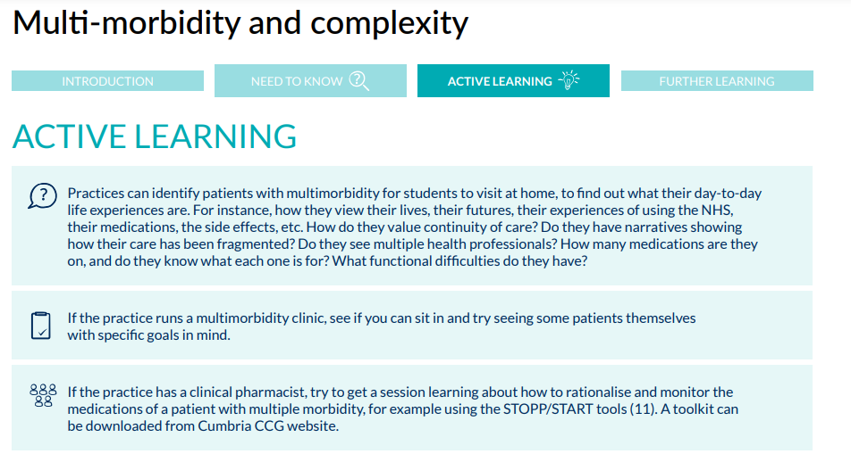

Slide 27
What do the patients say about medical students in GP?
Added value roles for medical students
"Even a wee phone call back to the patient to check if the x-ray or MRI [they were referred for] happened or check how they are getting on with their antibiotics."
"I'd like to see opportunity for video link for students - can make an appointment with students via video before seeing the GP. Let the student ask more questions - sometimes a video call of 10 mins can save the doctor time in their surgery."

Slide 28
Organisation and induction
Dr X provided amazing teaching and a safe space to learn, all doctors in the practice were welcoming and happy to teach, induction was really helpful to make us comfortable.
A clear timetable so I knew where to be everyday and who to go to if I had questions.
I was presented with a clearly defined timetable, with time slots and allocations from the very first day! one of the best and most flawlessly organised placements I have been on in the past 3 years.
We were asked what our most and least confident subjects were and they worked on a plan to ensure we improved our knowledge.

Slide 29
Clinical Learning Activity | How many | Who signs off
Attendance | 100% | Student
Experiences: Clinical encounters and management | 4 | Student
Experiences: Theme-based Learning | 6 | Student
Experiences: IDD audit | 7 (1 Form) | Student
WPBA: MiniCEX and Patient feedback | 2 | GP tutor
WPBA: Tutor feedback | 2 | GP Tutor

Slide 30
Theme-based learning
Supported by QUB
1.5 hr session/week
Themes: chronic pain (with expert patient)
safeguarding children
complexity (can be medically unexplained symptoms)
overdiagnosis/problematic polypharmacy
patient journey
social determinants of health
other

Slide 31
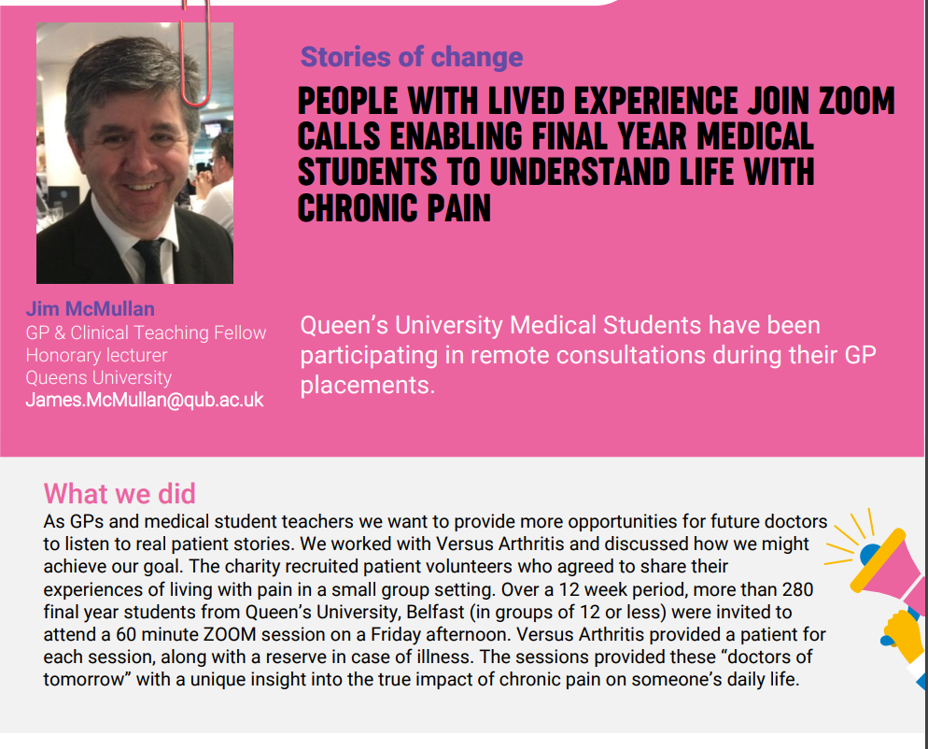

Slide 32
Example of a time schedule.
Week 1 | Morning | Afternoon
Monday | Introduction | ‘Shadow’ GP
Tuesday | Joint surgery | LTC clinic with PN/GPP (‘Shadow’)
Wednesday | Theme-based learning- QUB supported | Student surgery (undifferentiated)
Thursday | Triage | Emergency care with Duty doctor
Friday | Patient Journey | QI project

Slide 33
Week 4 | Morning | Afternoon
Monday | Student surgery (undifferentiated) | Discharges (IDD) and clinical encounters related to results/reviews
Tuesday | Student surgery (undifferentiated) | Student surgery (complex, routine)
Wednesday | LTC student surgery | Student surgery (selected e.g. multi-morbidity and reviews)
Thursday | Triage | Emergency care with Duty doctor
Friday | Theme-based learning- QUB supported | QI project

Slide 34
What do patients say about medical students in General Practice?
Informed consent
"I had an experience recently… they just told me as we were walking into that consultation. It's not really trauma-informed practice and I didn't have time to think about it. It kind of threw me off balance… it might be overstimulating to have multiple people in a consultation.“
"[Some patients] might be put on the spot and not like to be bombarded - prior warning would be good."
Transparency about knowledge gaps
"It would be good if patients could be notified ideally when they book the appointment so they have some time to think about it, or at least beforehand… as a patient with long-term conditions, it can be traumatising interacting with healthcare professionals."

Slide 35
Patients as experts in their own conditions
"When I was pregnant and my GP had students in one afternoon a week, he asked me to come in and speak to them. It was a really interesting process. It was the first time anyone had ever suggested that I was an expert in my own health."
"I'm sure you'd find families and people with learning disabilities who would come and talk to your students… it could be reassuring to know that's an integrated part of GP training."

Slide 36
Break

Slide 37



Progression

Slide 38
Half of all medical students will choose general practice as a career only when they see it is intellectually respected, as a research-based discipline.
Then they will understand its fascination and potential.

Slide 39
Value of GP placements (patient)
"I think it would be good for them to deal with complex situations… particularly as we get older, we have more conditions that are interrelated, giving them the opportunity to see people and discuss that with the patient."

Slide 40
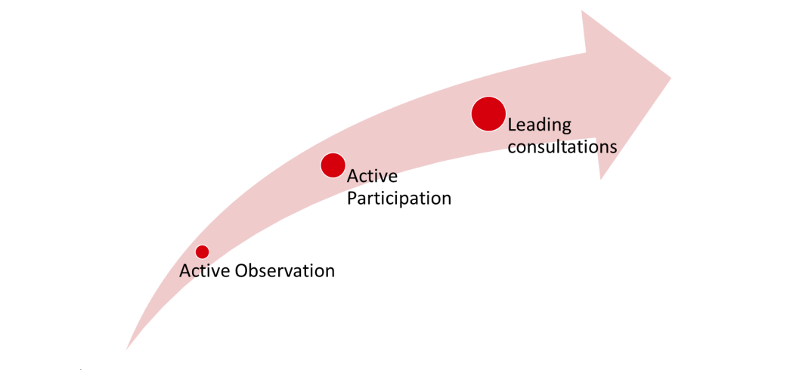

Slide 41
EPA (Entrustable Professional activity)
1. First introduction: observing only
2. Working together with supervisor: co-activity
3. Supervisor steps in as needed: direct supervision
4. Supervisor in the background: direct supervision
5. Supervisor in adjacent room and checks work at the end: indirect supervision
6. Supervisor in adjacent room and checks key aspects of work: indirect supervision
7. Supervisor at a distance but available by phone: indirect supervision
8. Fully independent consulting.

Slide 42
MiniCex
 | Above standard of a Y5 medical student | Meets standard of a Y5 medical student | Below standard of a Y5 medical student
History taking
Physical examination
Clinical Judgement
Professionalism
Global Impression
Anything especially good?
Suggestions for development?
Feedback from patient (How likely is it you would want to see the medial student again and why?)

Slide 43
Feedback
‘Given I was presenting patients for more than 8 times a day, I was receiving feedback on each and every one of my histories, examinations and management plans which has been an incredible tool for my practice, learning and development’ (student)
‘I think the students will learn a lot if I would be able to give some feedback’ (patient)

Slide 44
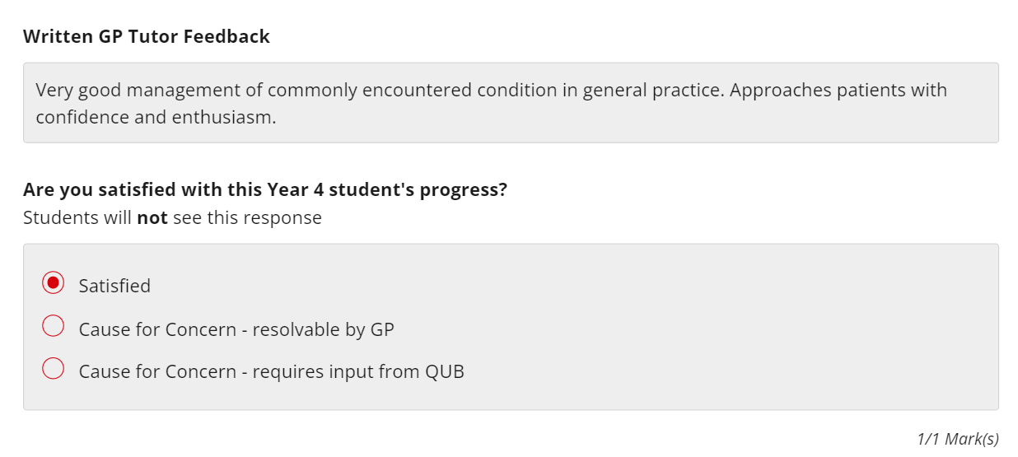

Slide 45
Concern
At mid-point and end of placement – use MyProgress feedback form with option to email gpadmin@qub.ac.uk
During the placement - email gpadmin@qub.ac.uk or m.dolan@qub.ac.uk

Slide 46
What will the students be doing in the other PfP2 and 3?
Acute ‘take’
Ward reviews
Discharge planning
‘Hot seating’ in OPD
2 weeks with the anaesthetics team
START course (Systematic Training in Acute Illness Recognition and Treatment)
2 days with Hospital at Home team, Time with specialist palliative care team
Pass the Bleep
Purple pen prescribing

Slide 47
Healthcare Human Factors (HHF):
The impact of different human factors on the safe and effective delivery of healthcare
One-week, face-to-face course on campus
Prescribing safety, conflict, error management, challenging conversations, near peer skills training, eye and ENT simulation stations, a reflective Schwartz round

Slide 48
SusQI (sustainable Quality improvement)
From September to December
In groups
One session a week
Conceptual or applied
Student training August 2024
Presentation and assessment of the posters in March 25

Slide 49
How do the PfPs link together?
Overarching Learning outcomes
Integrated care: discharge notes, prescribing, communication on the interface, patient journey
Activities: prescribing, triage, escalation, palliation, rehabilitation, optimalisation, prevention
Progression (towards F1): complexity, uncertainty, ‘hands-on’, independent safe practice

Slide 50
The Learning Outcomes - summary
Recognise and manage the acutely ill patient
Diagnose common presentations and conditions
Appreciate the importance of clinical, psychological, spiritual, religious, social, and cultural factors in establishing why people present to healthcare services and suffer disease and illness.
Demonstrate a patient-centred, holistic approach to management and treatment of their illness.
Communicate effectively with patients, their families/carers and with team members
Understand and deal with multi-morbidity, complexity and risk
Holistically develop a plan to manage patients in their post-acute phase
Recognise the holistic care, ethical considerations and communication around palliative and end-of-life care including ceiling of care
Recognise opportunities preventing disease and promoting health
Reflect on the impact on practitioner wellbeing of delivering healthcare
Integrate global and population healthcare principles in the provision of sustainable, effective patient care
Act according to professional values and within legal and ethical frameworks

Slide 51
Main points
When to expect the students
How to prepare
Timetable and induction
Understanding the curriculum and progression
What is expected from the students
Learning needs and activities
MyProgress -feedback

Slide 52
Plenary and questions

Slide 53
When are the students coming to the practice? Are there any days/weeks they will not be in practice?
What is expected from the tutor and the practice?
How has the student progressed until now and how can we help the student to progress further? What if I have a concern?
What kind of learning activities will the student be looking for or should we signpost the student to?
What is expected from the student?
Is there any signing off to be done?

Slide 54
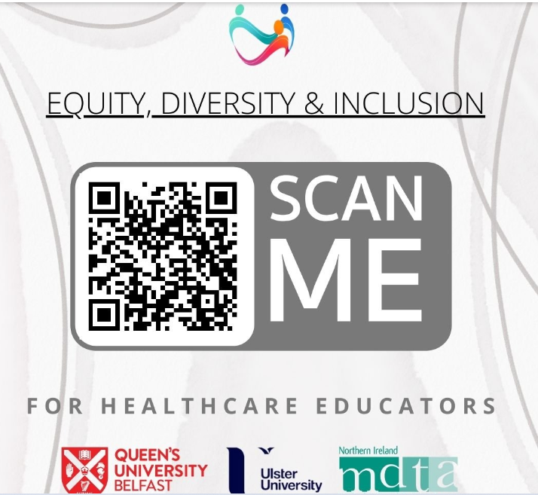

Slide 55
Survey- Annual Practice Return (15th of June)
If you taught medical students from any year group in 2023-24
Tell us how we can continue to improve medical student education in GP and support your team including the process of availability and allocations.
https://forms.office.com/e/z5Td85DBQS

Slide 56
Dates for your diaries
GP Tutors and Training Meetings for 2024-25
Year-5-GP-C25 training: 7th June or 13th June 2024 PM
Year-4-GP-C25-training: 26th June 2024 PM
Year-3-GP Training-session: 3rd September 2024 PM
Annual GP Tutor meeting: 4th September 2024 PM
Year 1 & 2 Family Medicine 11th September 2024 PM (in person)

Slide 57

Thank you
He who studies medicine without books sails an uncharted sea, but he who studies medicine without patients does not go to sea at all.
William Osler
m.dolan@qub.ac.uk
https://www.qub.ac.uk/sites/qubgp/

